Slide 1

HSL and DLLs
How to link HSL to external code

Slide 2
HSL and DLLs
Slide Subtitle
1 | HSL Libraries
2 | Structure of HSL libraries
3 | Linking External Code
4 | Register dll
5 | Checksum library example
6 | The power of C#
7 | Additional learning

Slide 3
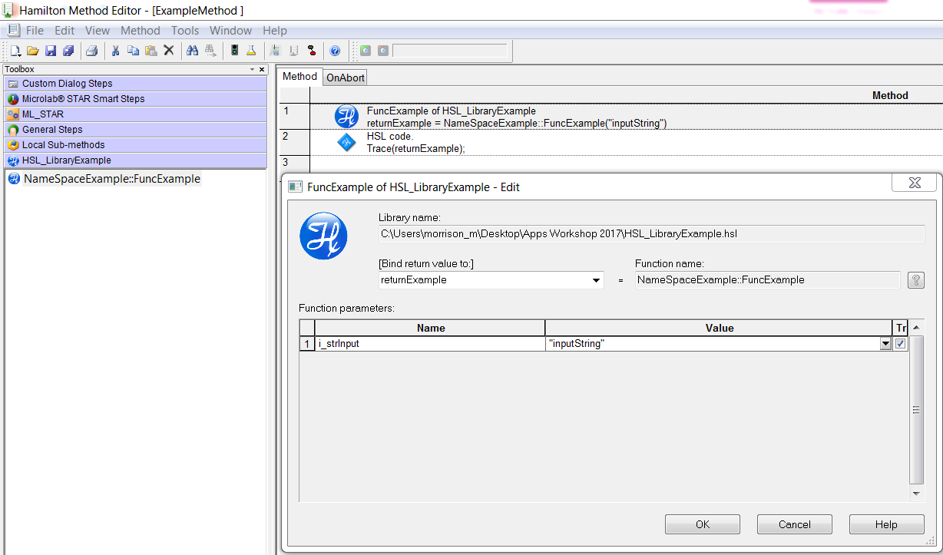
HSL Libraries
Reasons to learn
What is an hsl library
An HSL library is a “collection” of functions written in HSL code and available for use in Venus software
HSL Libraries are written in the HSL Method editor found in
C:\Program Files (x86)\HAMILTON\Bin
Why create an HSL library
HSL libraries can be used to link outside code to Venus
Make complex or redundant code reusable
Extend functionality of Venus
Link Venus function to external code
Notes:
Show example method included in master folder

Slide 4
HSL Libraries
The Basics
The steps
Create new method in HSL method editor
Create new Namespace
Add in HSL Functions

Slide 5
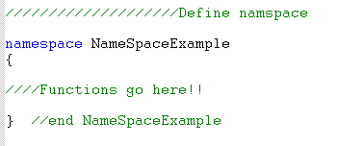


HSL Code
Library Structure Basics
The Name space
HSL libraries begin with a namespace declaration
The namespace must be unique from all other libraries
All library functions go between opening and closing brackets { }

Slide 6
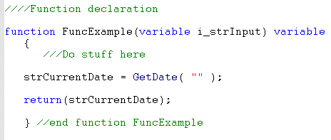
HSL Code
Library Structure Basics
Function declaration
Defines inputs and return type
Function Name
Input Variable
Return Variable

Slide 7
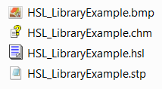
HSL Code
Library Structure Basics
Adding an icon
Simply add a .bmp with same file name as .hsl file
Help File
.chm file extension
Use [LibraryName].chm
Create using HTML Help Workshop

Slide 8
HSL C# Integration
The Basics
The steps
Create Class Library Project in Visual Studio
Write code and Compile DLL
Register DLL
Insatiate class in HSL
Use instantiated class

Slide 9
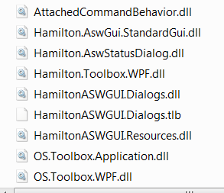
Linking C#
Linking External code
DLL
Stands for "Dynamic Link Library." A DLL (.dll) file contains a library of functions and other information that can be accessed by a Windows program. When a program is launched, links to the necessary .dll files are created. If a static link is created, the .dll files will be in use as long as the program is active. If a dynamic link is created, the .dll files will only be used when needed. Dynamic links help programs use resources, such as memory and hard drive space, more efficiently.
DLL’s used in ASW Dialog Library

Slide 10
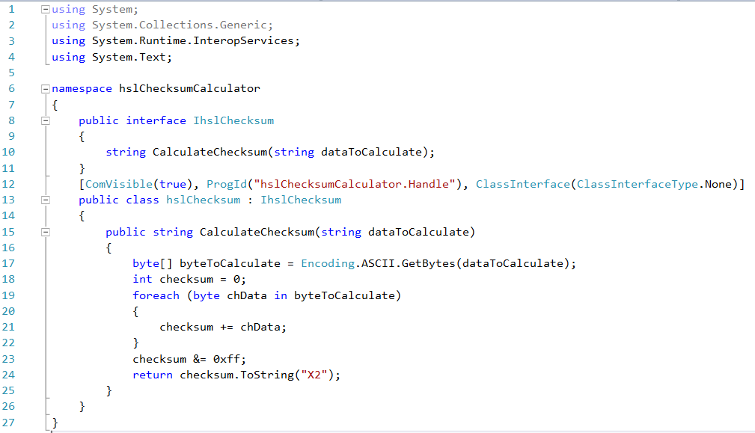
C# DLL
Checksum Calculator Example
Notes:
Use Visual Studio solution found in master folder to show how to compile into dll

Slide 11
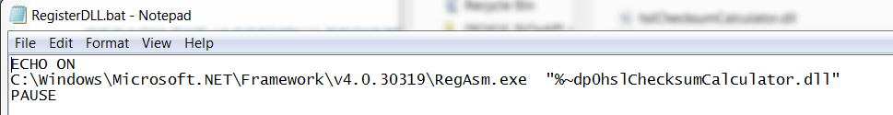
Linking C#
Linking External code
Regasm.exe (Assembly Registration Tool)
The Assembly Registration tool reads the metadata within an assembly and adds the necessary entries to the registry, which allows COM clients to create .NET Framework classes.
This will allow C# classes to be accessed by HSL code
Notes:
.bat file used here as example is in master folder. Explain how to register dll with it

Slide 12
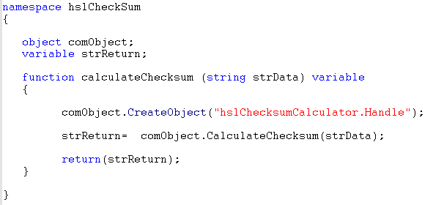
HSL Code and C#
Checksum Calculator Example
Class instantiation
Instantiate - Instantiating a class means to create a new instance of the class.
By instantiating the C# class from its ProgId as an HSL object we are creating a new instance of the class
C# Function used in HSL code

Slide 13
HSL and C#
Reasons to learn
The power of C#
Can link Venus to powerful APIs
Communication with devices
Back Bone of Venus Software
SILA Drivers written in C#

Slide 14
Thank You
www.hamiltoncompany.com 800-648-5950 Hamiltoncompany.com/contacts

